Slide 1
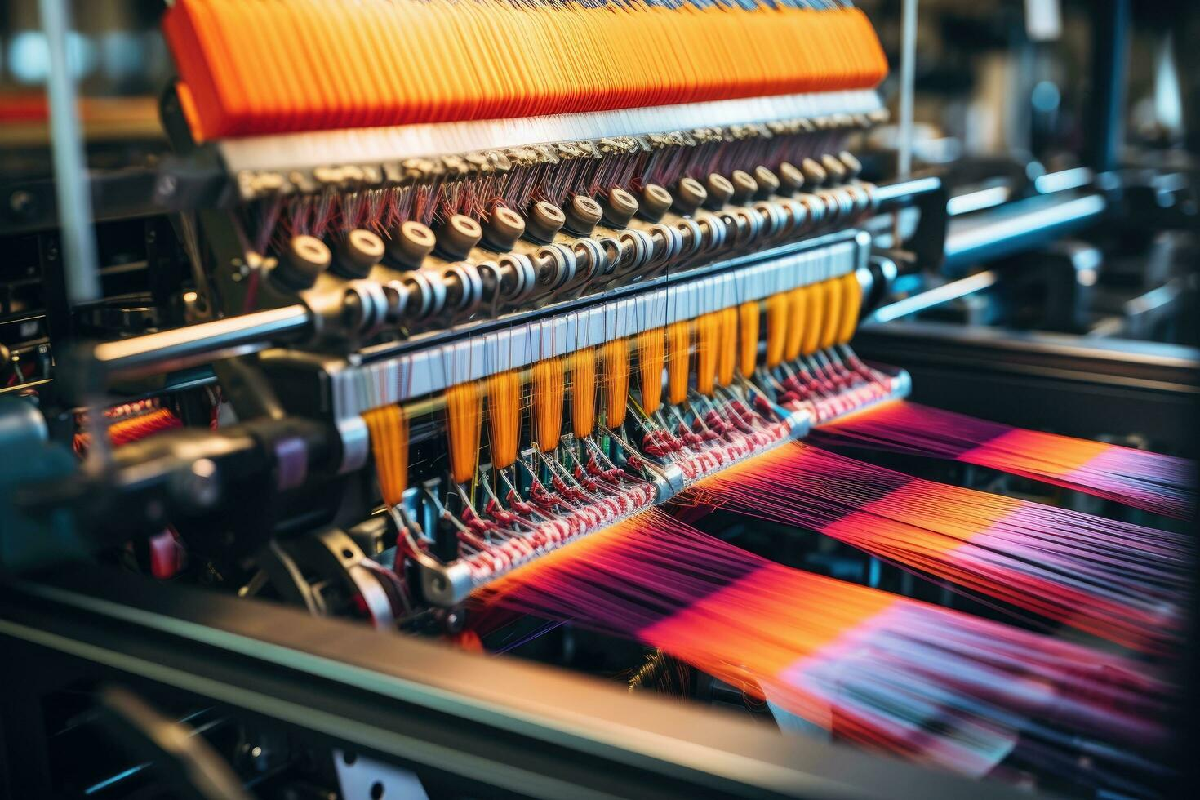
Textile Management System
Submitted By:
Rakibul Hasan Ridoy (1731339042)
Md.Muntasir Abid (2212773042)
Rokib Hasan Shuvo (2121827642)
Sk. Mohammad Abrar Rahman (2122436642)
Submitted To:
Mohammad Shifat-E-Rabbi (Assistant Professor)

Slide 2
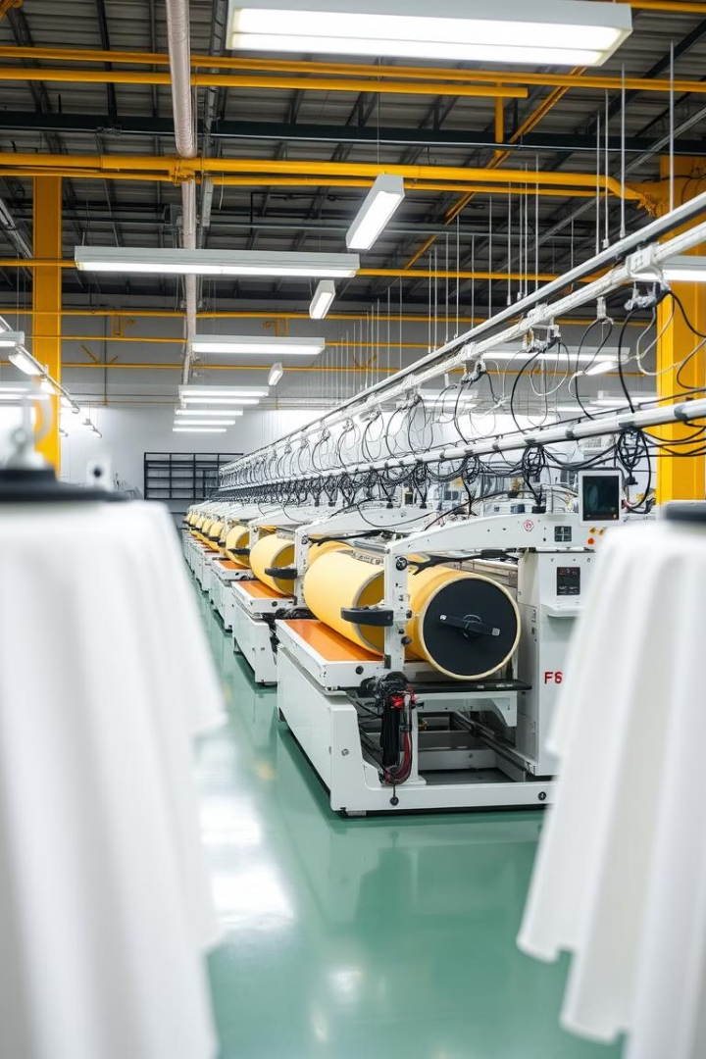
Introduction to Textile Management
Definition
Importance
A Textile Management System (TMS) is an integrated software solution that helps to automate and streamline the processes in the textile sector. From procuring raw materials to manufacturing,stocking, selling and distributing products.The textile sector works with complex supply chains, forms, and intricate operations.
Textile management software systems are designed to help manufacturers, wholesalers and retailers of textile businesses their record keeping, real time inventory management vs current situation discrepancies, production cycle optimization and customer satisfaction.

Slide 3
Introduction to Textile Management
Importance
Importance
Improved Record-Keeping
Real-Time Inventory Management
Produce Cycle Optimization
Enchance Customer Satisfaction
Textile management software systems are designed to help manufacturers, wholesalers and retailers of textile businesses their record keeping, real time inventory management vs current situation discrepancies, production cycle optimization and customer satisfaction.

Slide 4
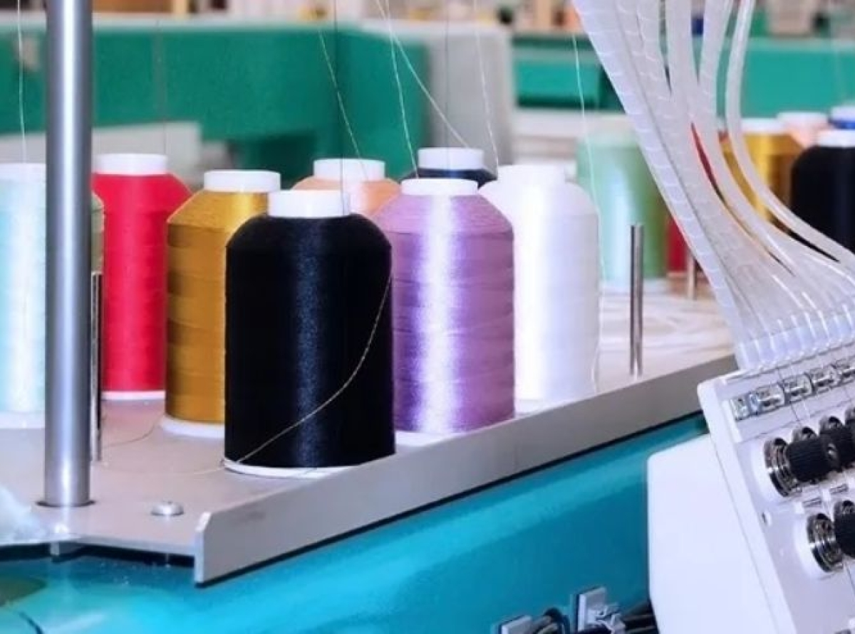
Key Components of a Textile Management System
1
Order Receiving
2
Add Order
Entering new orders into the system with all necessary details for processing..
The process of accepting and recording customer orders, ensuring accuracy and clarity
3
Sampling
Creating and managing product samples for customer approval or quality checks.

Slide 5

Key Components of a Textile Management System
4
Manage Order
5
Manage Customer
Maintaining customer information, addressing inquiries, and building relationships.
Overseeing and tracking all orders to ensure timely fulfillment and updates.
6+
Manage Entries
6
Recording and organizing data entries related to orders, inventory, or transactions.

Slide 6
Key Components of a Textile Management System
7
Processing
8
Production
Manufacturing or assembling products according to order specifications.
Handling and preparing orders for the next stages, including quality checks..
9
Manage Employees
Overseeing staff schedules, performance, and responsibilities.

Slide 7
Key Components of a Textile Management System
10
Warehouse
11
Shipment
Packaging and dispatching orders to customers, ensuring timely delivery.
Storing, organizing, and managing inventory for order fulfillment.
12
Bills
Generating and managing invoices, payments, and financial records.

Slide 8
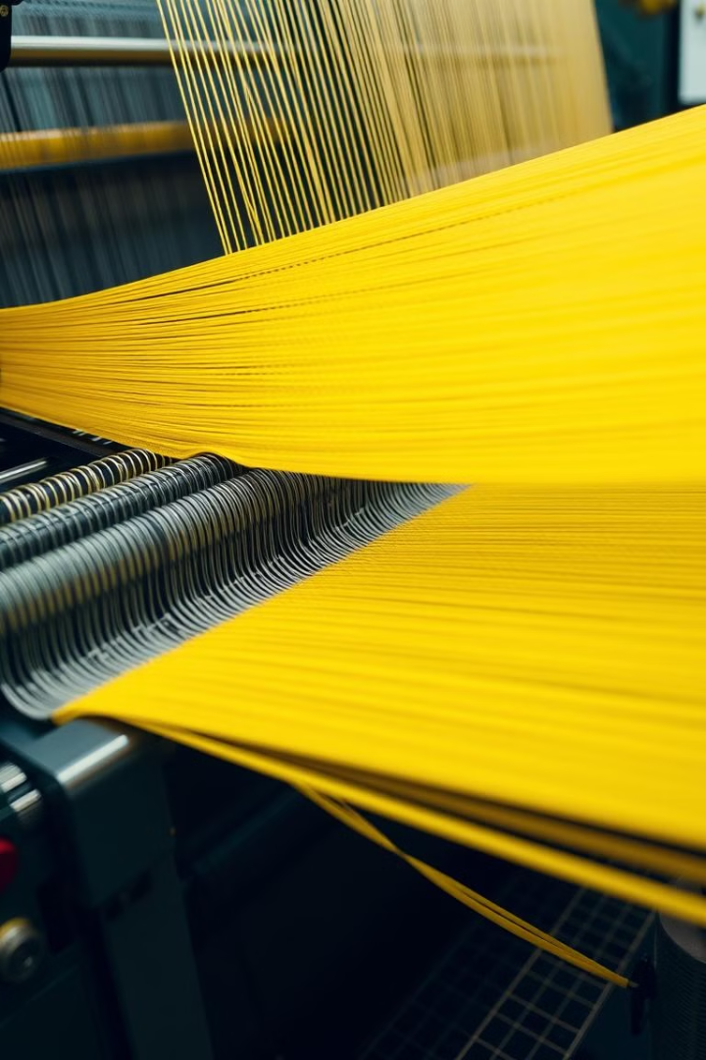



Production Planning and Scheduling
Creating production schedules based on demand forecasts. Ensures timely completion of orders.
Scheduling
Resource Allocation
Distributing resources efficiently, including machinery and labor. Maximizes output.
Capacity Planning
Assessing production capacity, it identifies potential bottlenecks.

Slide 9
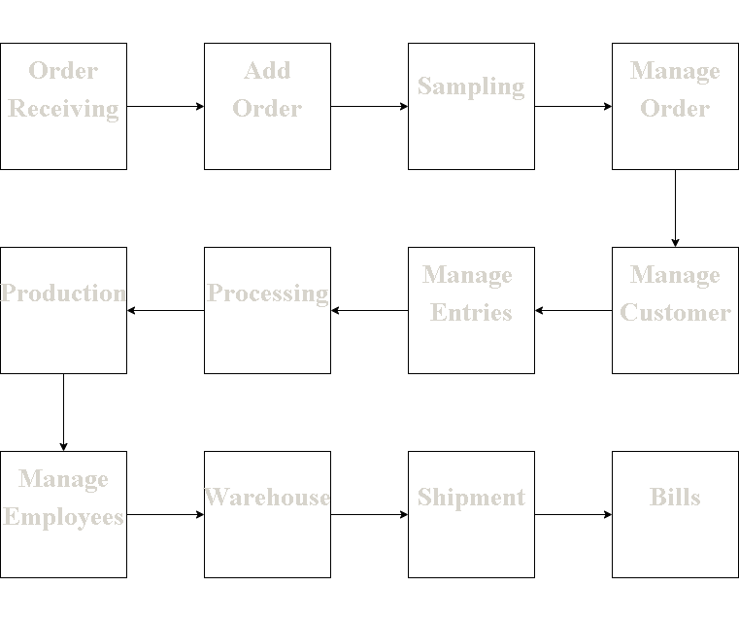
Data Flow Chat

Slide 10
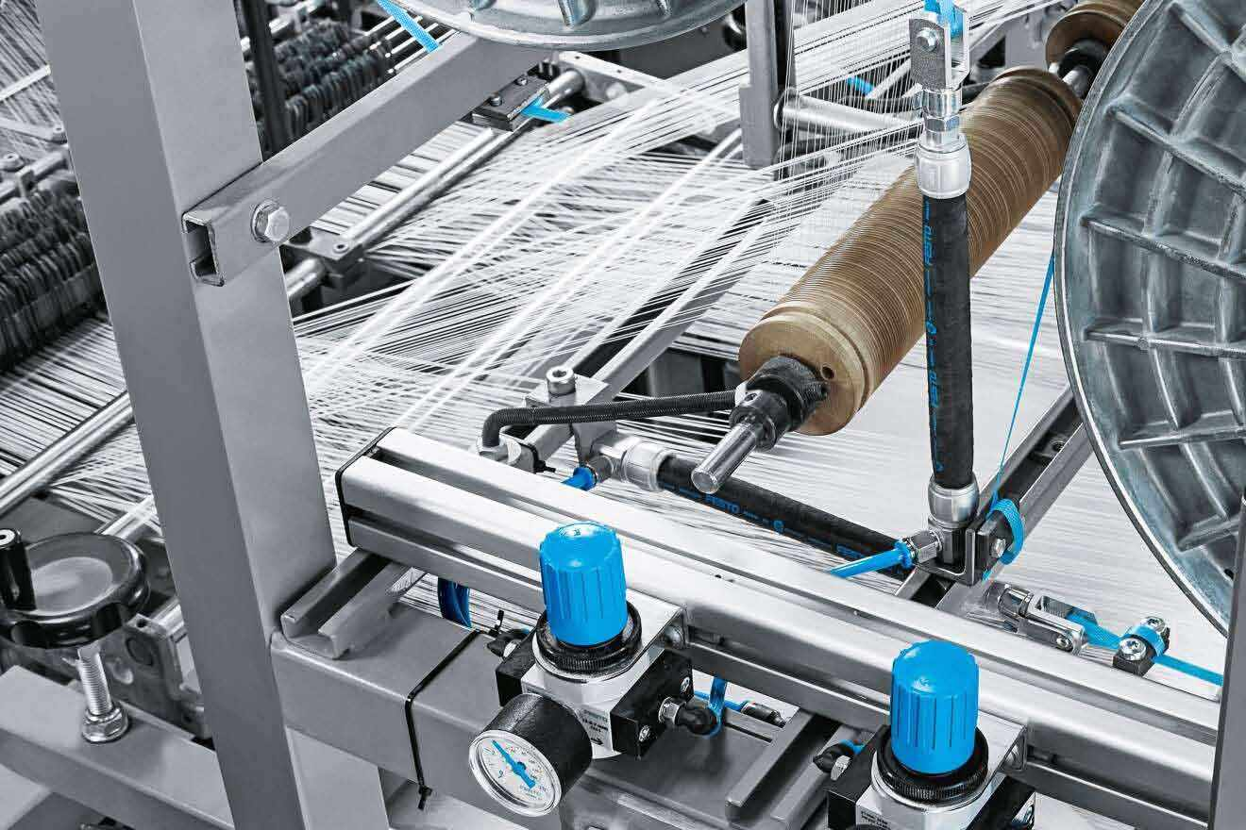
Conclusion
Wrapping things up, Our Textile Management System enhances efficiency by streamlining inventory, orders, and production processes. It optimizes resource utilization, reduces manual errors, and improves decision-making. This system ensures smooth operations, cost-effectiveness, and better customer satisfaction, making it a valuable tool for modern textile industries to stay competitive and well-organized.

Slide 11
Any Questions?

Slide 12
Thank You

